Slide 1
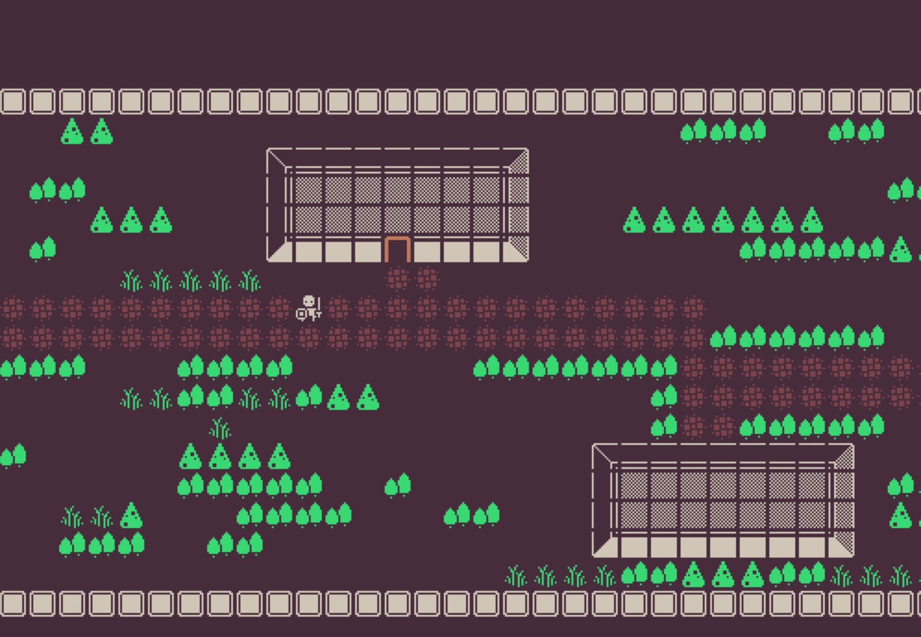
LEGEND OF MARTIN
THE SAGA OF BETRAYAL
(Special thanks to Nitram137 for contributing)

Slide 2
THIS WEEK
Implement a roguelike game JavaFX
TASK
CHALLANGE

Slide 3
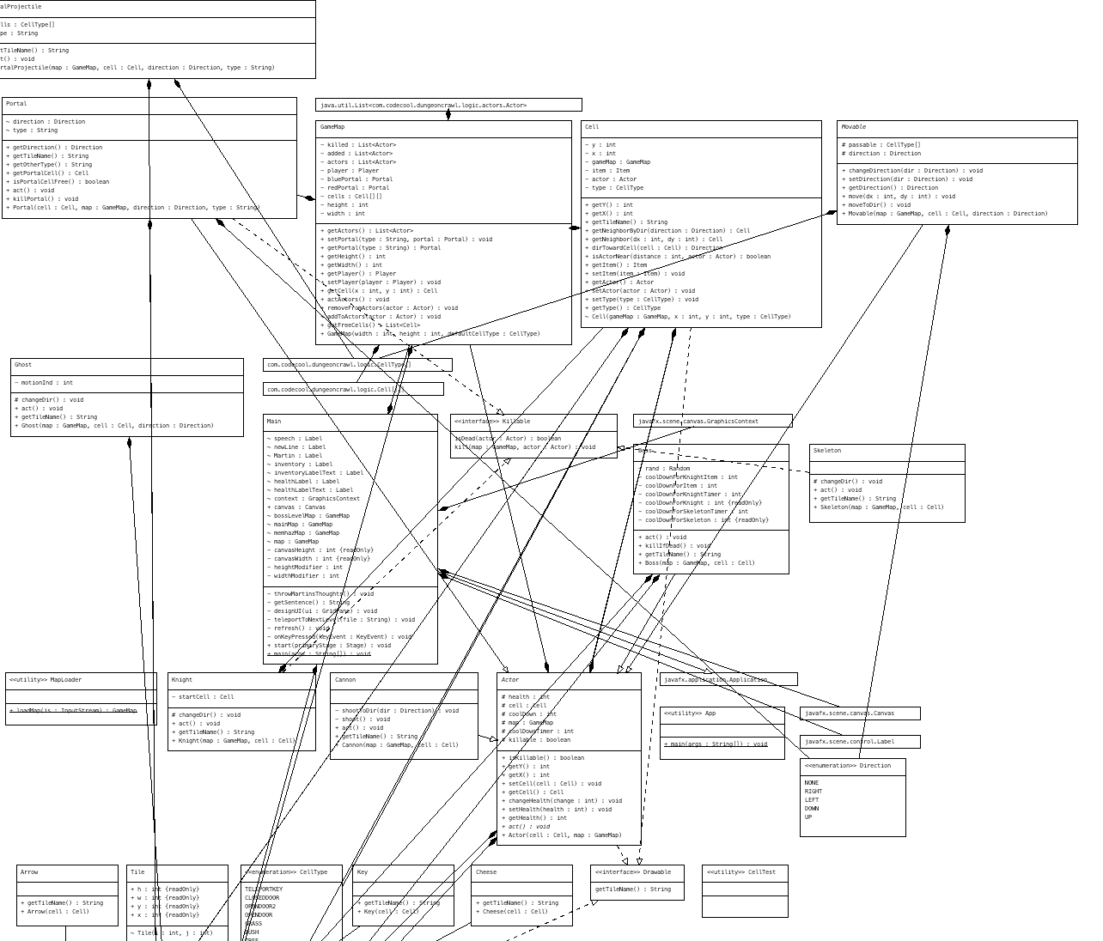
UML CLASS DIAGRAM

Slide 4



PLAYER
SHOOT
TELEPORT WITH PORTAL GUN

Slide 5



MONSTERS
Knight
Ghost
Skeleton

Slide 6



ITEMS
Cheese
Arrow
Key

Slide 7
BOSS
?
?
vs
?

Slide 8
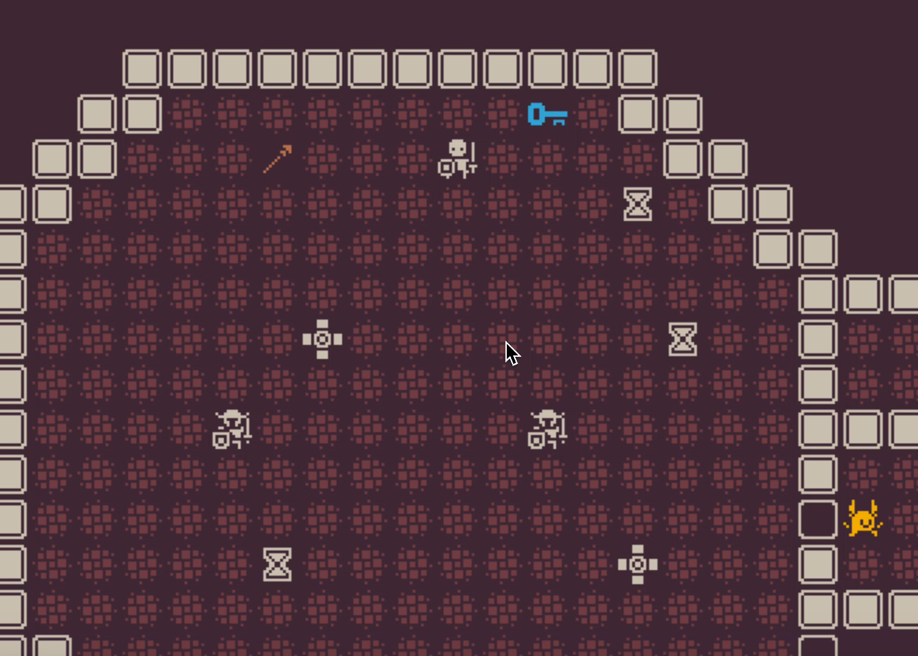
LET’S PLAY!

